Slide 1
Message Authentication
Message authentication is important where undetected manipulation of messages can have disastrous effects.

Slide 2
Why Message Authentication?
Message authentication is important where undetected manipulation of messages can have disastrous effects.
Message authentication is a mechanism or service used to verify the integrity of
a message.
Message authentication assures that data received are exactly as sent
(i.e., there is no modification, insertion, deletion, or replay)

Slide 3
MESSAGE AUTHENTICATION FUNCTIONS
Message Encryption: The ciphertext of the entire message serves as its authenticator
Message Authentication Code (MAC): A function of the message and a secret
key that produces a fixed-length value that serves as the authenticator
Hash Function: A function that maps a message of any length into a fixed-length
hash value, which serves as the authenticator

Slide 4
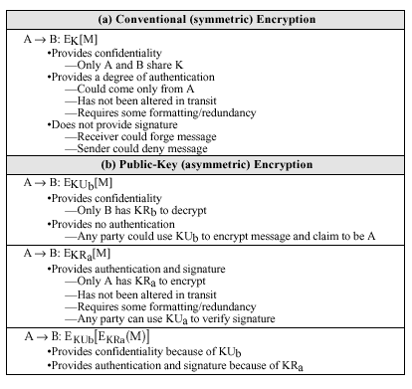
Message Authentication Using Plain Encryption

Slide 5
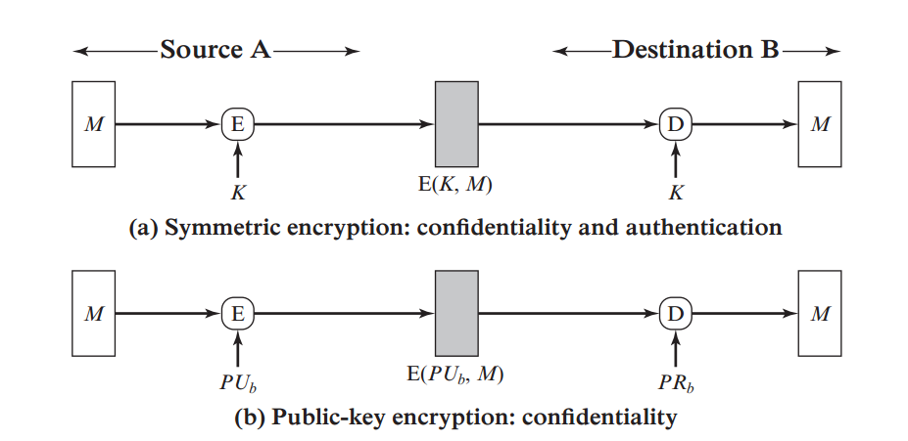
Message Encryption

Slide 6
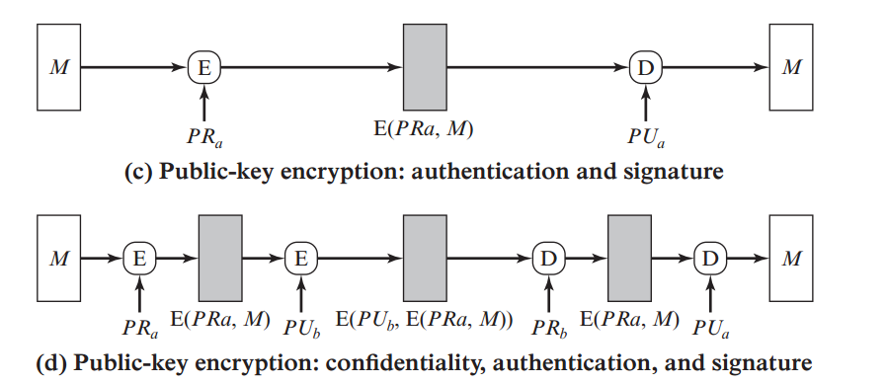
Message Encryption

Slide 7
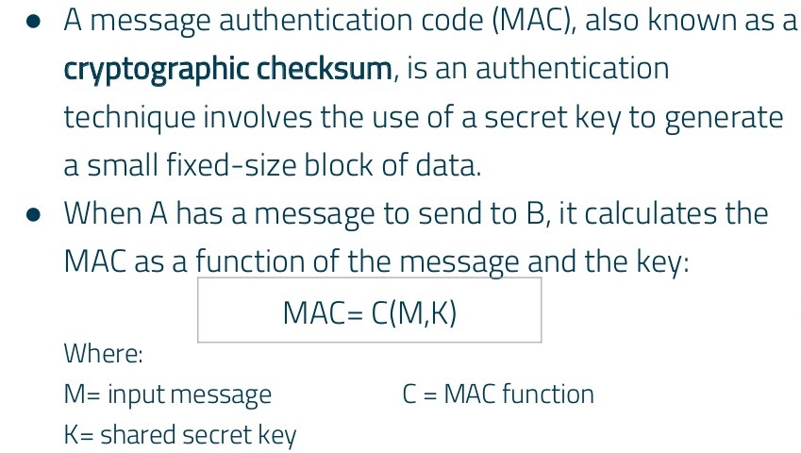
Message Authentication Code (MAC)

Slide 8
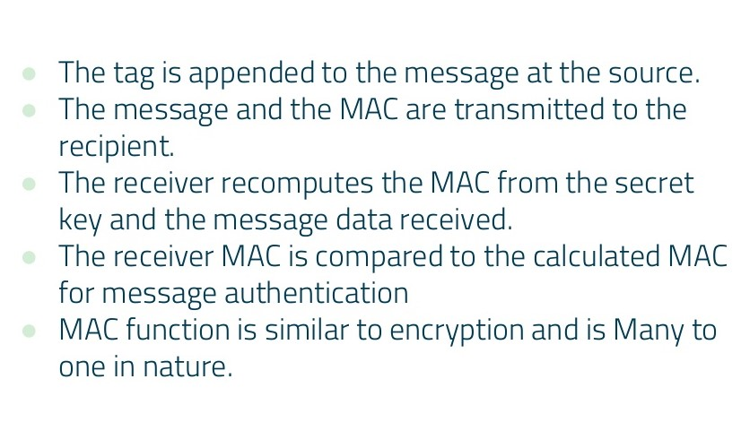
Message Authentication Code (MAC)

Slide 9
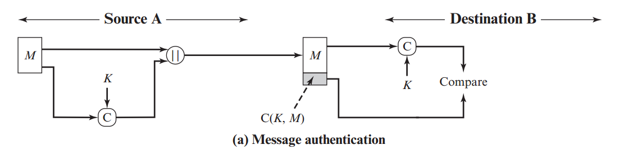
Message Authentication Code (MAC)

Slide 10
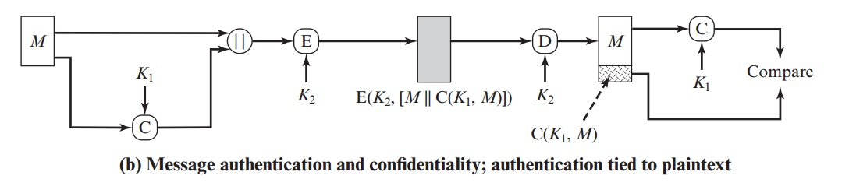
Message Authentication Code (MAC)

Slide 11
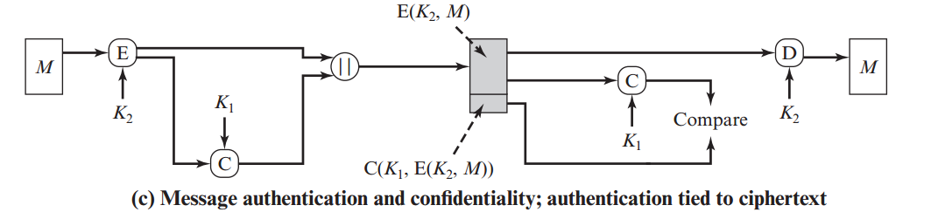
Message Authentication Code (MAC)

Slide 12
Hash Function
A hash function H is a transformation that takes an input m and returns a fixed-size string, which is called the hash value h (that is, h = H(m)).
Hash functions with just this property have a variety of general computational uses.

Slide 13
Requirements for Cryptographic Hash Functions
The basic requirements for a cryptographic hash function are as follows.
  The input can be of any length.
  The output has a fixed length.
  H(x) is relatively easy to compute for any given x.
  H(x) is one-way.
  H(x) is collision-free.

Slide 14
H(x) is one-way ...
A hash function H is said to be one-way if it is hard to invert, where ``hard to invert'' means that given a hash value h, it is computationally infeasible to find some input x such that H(x) = h.

Slide 15
Hash Functions as Message Digests
The hash value represents concisely the longer message or document from which it was computed; this value is called the message digest.
One can think of a message digest as a ``digital fingerprint'' of the larger document.
Examples of well known hash functions are MD5 and SHA.

Slide 16
Hash Function
The sender computes a hash value as a function of the bits in the message and transmits both the hash value and the message.
The receiver performs the same hash calculation on the message bits and compares this value with the incoming hash value.
If there is a mismatch, the receiver knows that the message (or possibly the hash value) has been altered.

Slide 17
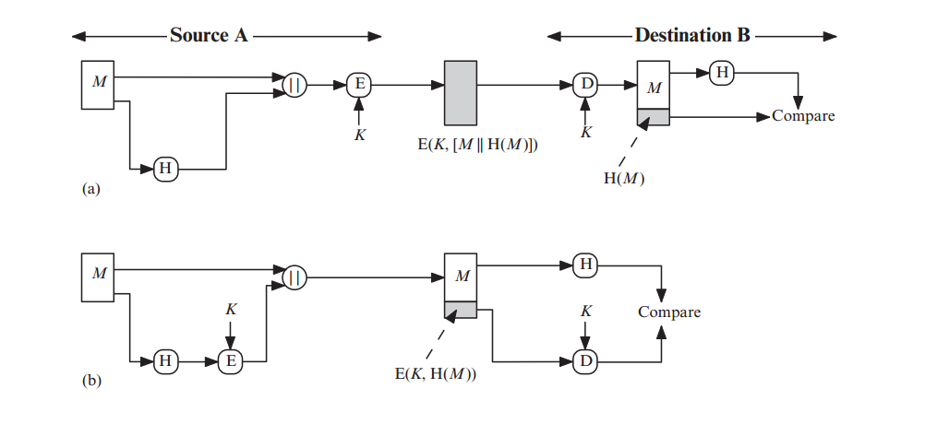

Hash Function

Slide 18
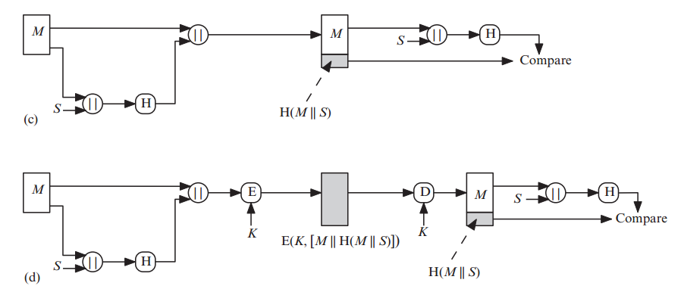

Hash Function

Slide 19
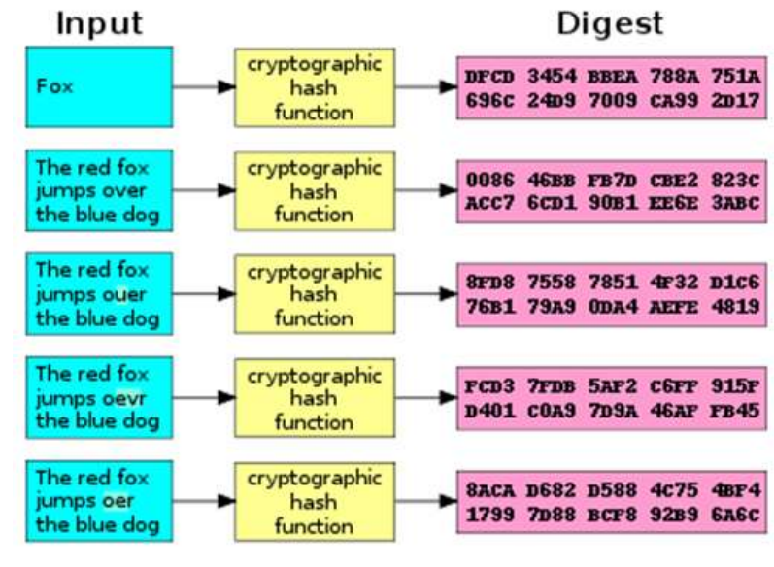
Hash Function

